Slide 1
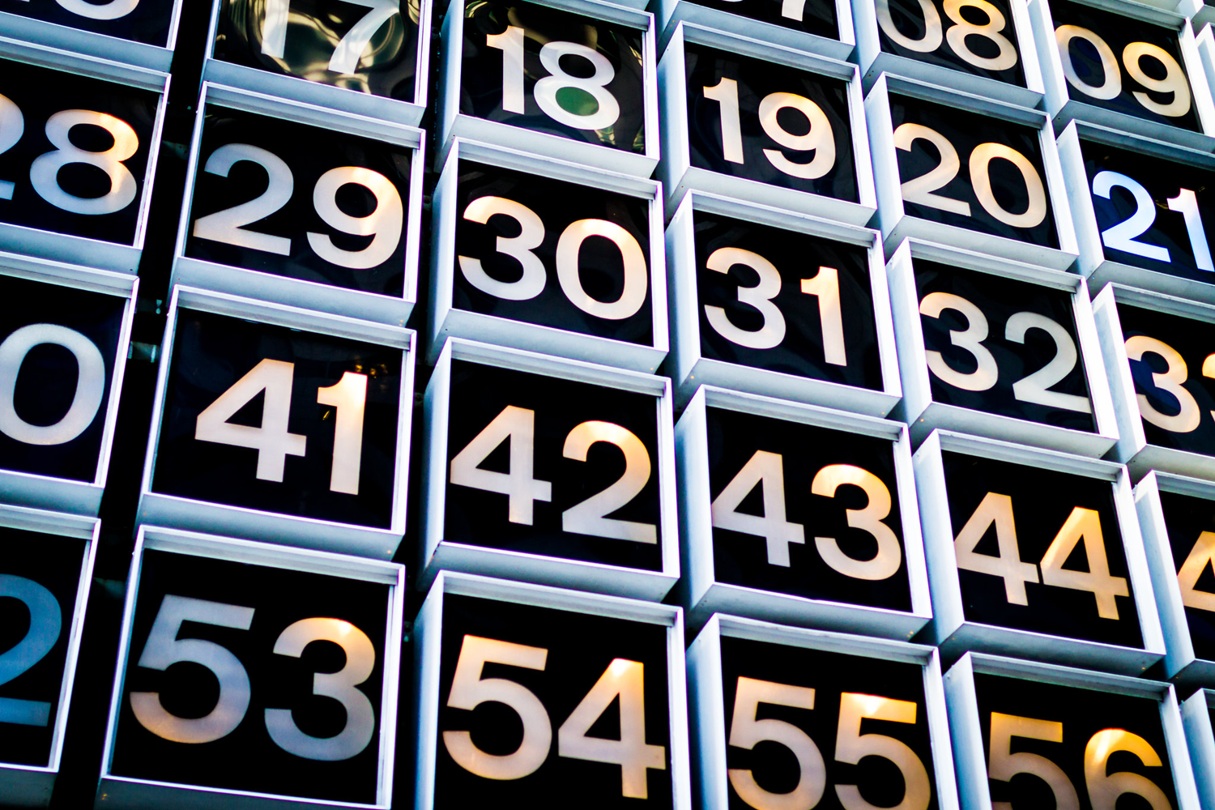

Gathering Secondary Data
IL “Data and Decision Making” SS 26
Kami Höferl
(MervC, CC-BY-NC 2.0)

Slide 2
Overview
Secondary Data (?) …
… and Where to Find Them
Validating Secondary Data
Time 4 some Action
Detour: Encoding
(MervC, CC-BY-NC 2.0)
(Escher, 1961)

Slide 3
Secondary Data … remember?

Slide 4
Primary vs. Secondary Data
Measuring primary data | Finding secondary data
Previously unavailable Generated by (own) measurement Precisely tailored to research questions Often time-consuming | Derived or derivable from primary data Ideally stored in repositories Generated through classification, aggregation and/or generalization Can be tailored precisely to research questions Less effort required*

Slide 5
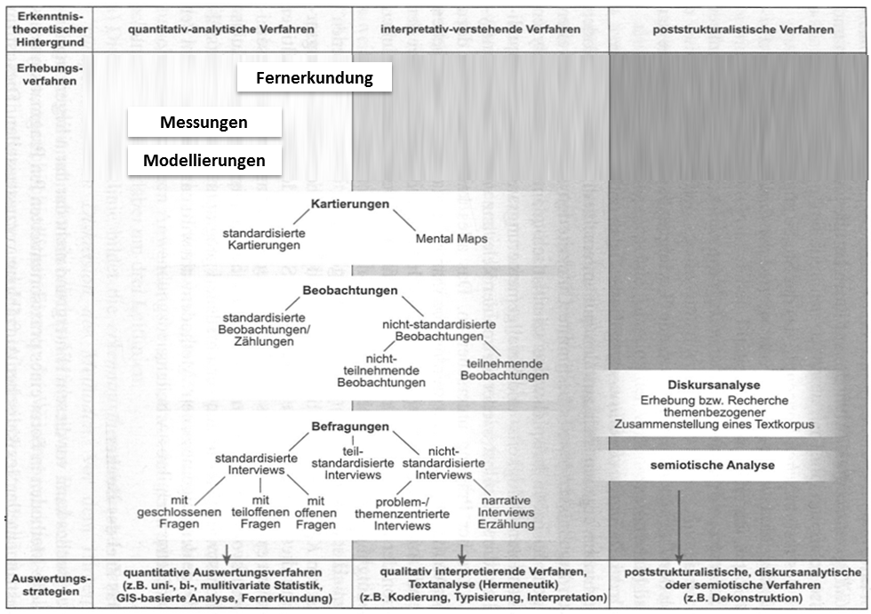
How Primary Data are Made

Slide 6
How Secondary Data is Made
Secondary data
Mostly: obtained by processing primary data
Own creation
Creation by third parties
Subsequent digitisation of analogue data sets from third parties

Slide 7
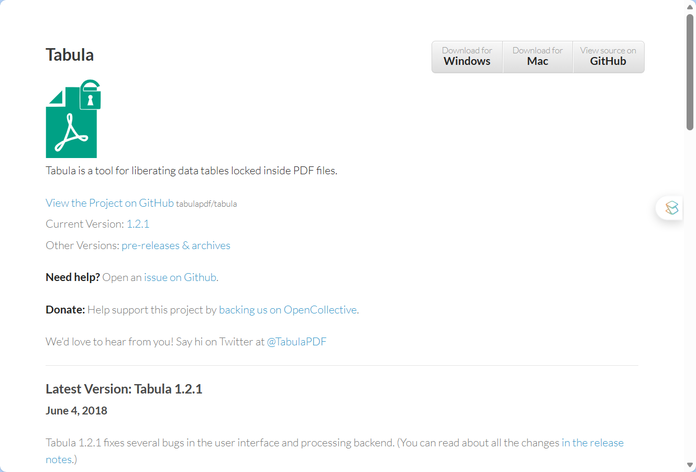
@ Subsequent Digitisation
Conversion errors
increased time required for quality assurance
Developing (historical) data sets
Depending on input-quality 👉 errors in coding

Slide 8
How Secondary Data is Made
Processing:
Classification:
Classification into categories of things with common characteristics
Aggregation:
Grouping existing classes into new ones (→ Definition of a new class)
Generalisation:
Definition of subset relationship between elements of different classes

Slide 9
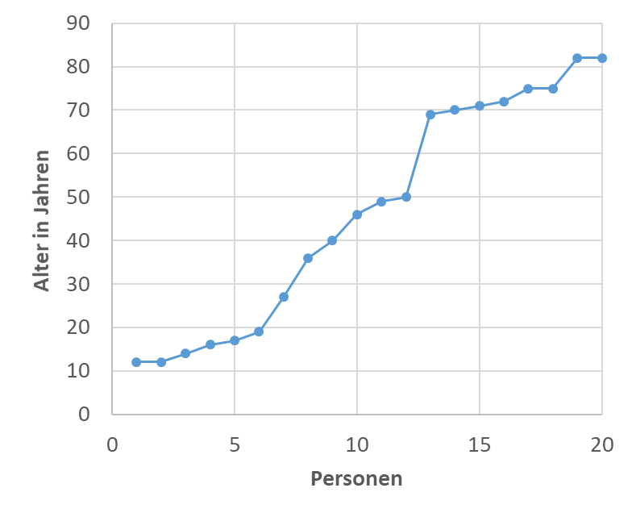
Classification vs. Aggregation
Classification
Aggregation
65
65
18
18
bis 18
19 bis 65
65+
bis 18
19 bis 65
65+
Erwerbs-unfähigen
Erwerbsfähigen
Erwerbsunfähigen

Slide 10
Generalisation
Erwerbsfähige Personen (18 bis 65)
Erwerbstätige
Selbständig Erwerbstätige
Unselbständig Erwerbstätige
Arbeitslose
Personen in Ausbildung
Schatten-wirtschaft
Freiwilligen-arbeit
Frühpensionierte
Gewerbl. Erwerbstätigkeit
Urproduktion
Freiberufl. Tätigkeit
„Neue“ Selbständigkeit
ÖNACE A: Land- & Forstwirtschaft, Fischerei
…
ÖNACE U: Exterritoriale Organisationen
Freie Gewerbe
Reglementierte Gewerbe
Entity-Relationship Model: is-a-Beziehung

Slide 11
… Where to find Them

Slide 12
A typical Workflow
Reduction
Imputation
Aggregation
Classification
Generalisation
Documentation
Encoding problems
Data types
Labels
Completeness
Missing Values
Plausibility
Collect
Repositories
Define research questions
Data acqui-sition
Import data
Explore & validate data
Modify data
Model data
Validate models
Evaluate models
Documentation
Summarise findings
Univariate
Bivariate
Multivariat
Segment data record
Sensitivity analysis
Explanatory power
Number of variables
Effect strength

Slide 13
Selected Repositories
Secondary data:
Purchase
:👉impact on subsequent archiving
Open & FAIR Data
Pay attention to the licence
General: Metadata
Extraction
Processing
etc
Repositorium | Kurzbeschreibung | Typische Datenlizenzen
Open Data Austria | Zentrales österreichisches Open-Data-Portal mit Verwaltungs-, Umwelt- & Statistikdaten | CC BY, CC BY-SA, CC0
Zenodo | Forschungsdaten-, Software- & Publikationsrepositorium | CC BY, CC0, ODC-BY, MIT
OpenAIRE | EU-weite Infrastruktur zur Auffindbarkeit von Forschungsoutputs & Datensätzen | Abhängig vom Quellrepositorium
European Data Portal | Aggregator für Open Data aus EU-Mitgliedsstaaten & Institutionen | CC BY, CC0, nationale Varianten
GESIS Data Archive | Sozialwissenschaftliche Forschungsdaten mit Fokus auf Europa | CC BY, Data Use Agreements
CESSDA | Konsortium nationaler sozialwissenschaftlicher Datenarchive | CC BY
UK Data Service | Umfangreiche sozial- & wirtschaftswissenschaftliche Datensätze | CC BY, UK Open Government Licence
Notes:
Findable (Auffindbar)
Accessible (Zugänglich),
Interoperable (Interoperabel) und
Reusable (Wiederverwendbar)

Slide 14
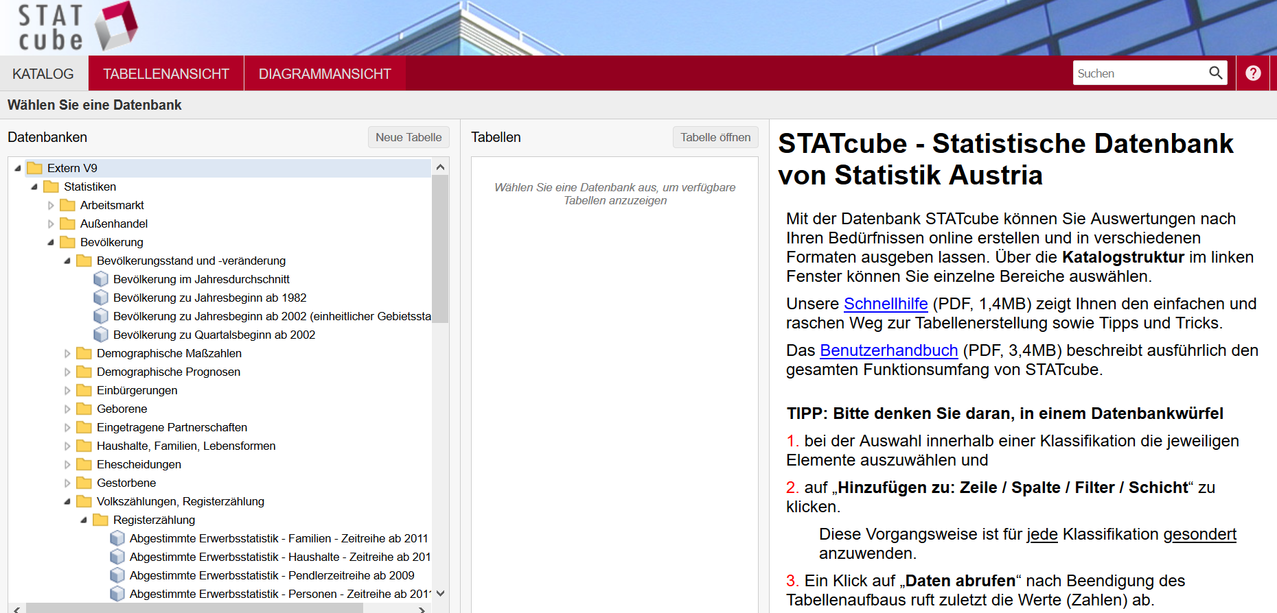
Selected Repositories
https://statcube.at

Slide 15
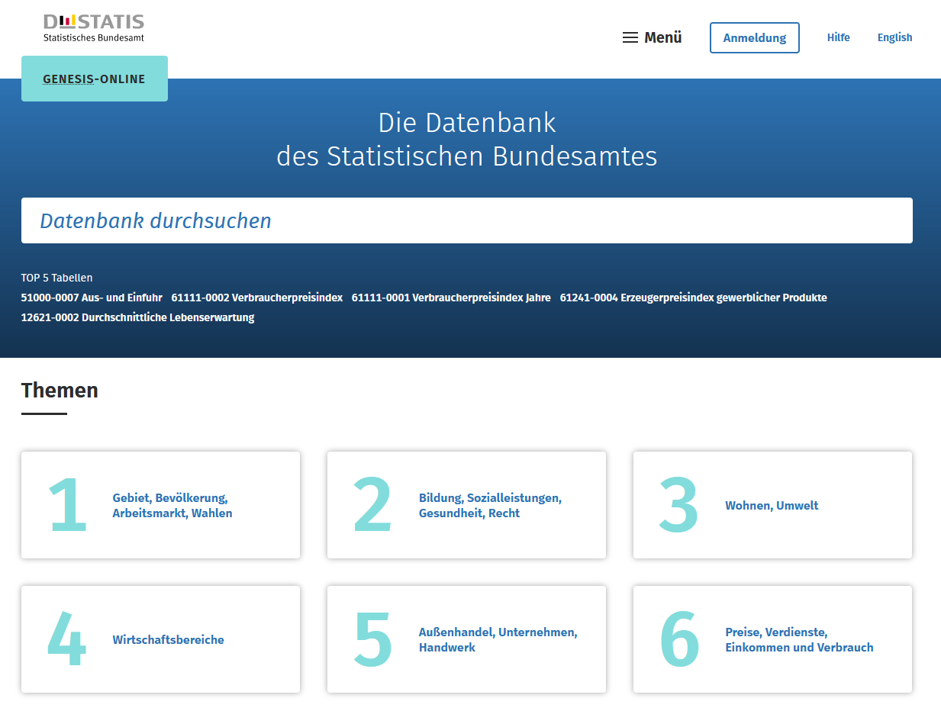
Selected Repositories
https://www-genesis.destatis.de

Slide 16
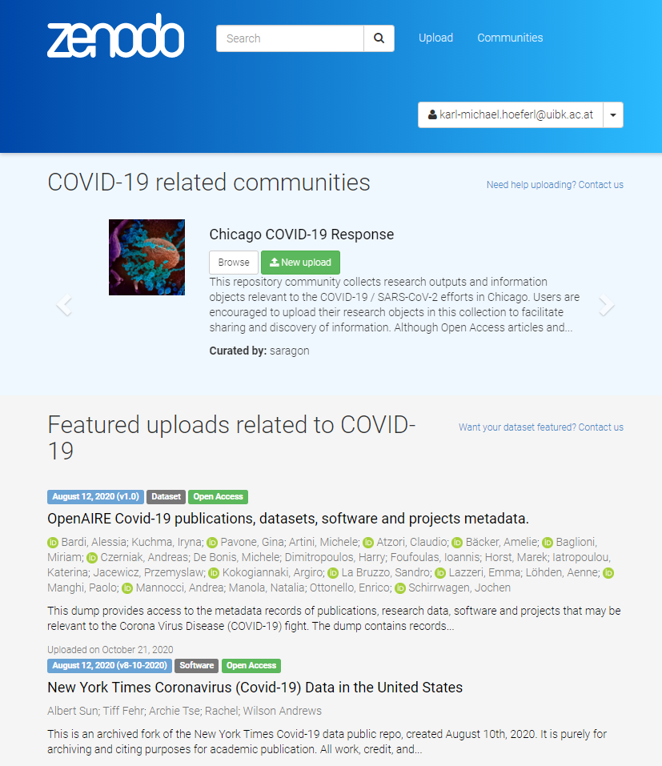








Selected Repositories

Slide 17
Selected Repositories
Wikidata: https://www.wikidata.org
gesis: https://www.gesis.org
European Data Portal: https://data.europa.eu
OECD Data: https://data.oecd.org/
UNdata: https://data.un.org/
NASA Socioeconomic Data and Application Center: https://sedac.ciesin.columbia.edu/
Registry of Research Data Repositories: https://www.re3data.org/

Slide 18
Validating Secondary Data

Slide 19
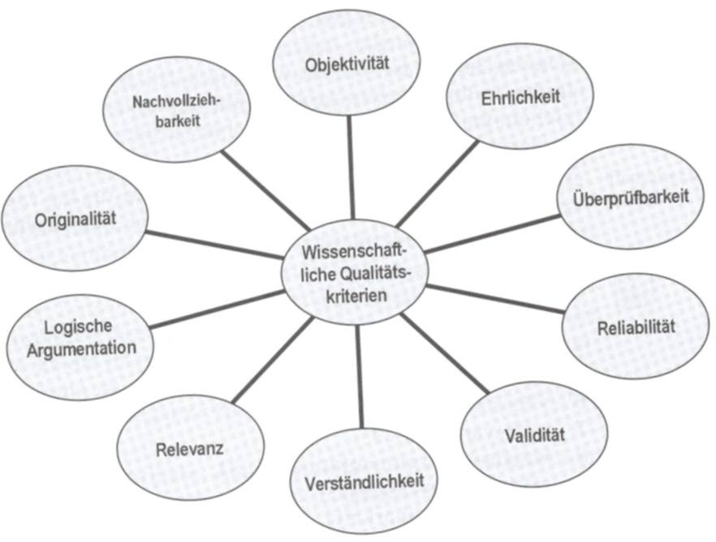
Quality & Suitability of Secondary Data
Images excluded
Relevance → Question
Institutional origin
Traceability
Survey method
Objectivity
Reliability
Validity
Processing
Comprehensibility
Usability
Licence
C-A10-0;C-B00-0;C-C11-0;F-ISIS-568
A10-1982;B00-1;C11-1;129951
A10-1982;B00-1;C11-2;140571
A10-1982;B00-1;Total;270522
A10-1982;B00-2;C11-1;258738
A10-1982;B00-2;C11-2;279179
A10-1982;B00-2;Total;537917
A10-1982;B00-3;C11-1;687036
A10-1982;B00-3;C11-2;749121
A10-1982;B00-3;Total;1436157
A10-1982;B00-4;C11-1;612958
A10-1982;B00-4;C11-2;663793
A10-1982;B00-4;Total;1276751
A10-1982;B00-5;C11-1;212673
A10-1982;B00-5;C11-2;233449
A10-1982;B00-5;Total;446122
A10-1982;B00-6;C11-1;568402
Documentation Metadata
jahr | brp_mio | anteil_wien | brp_ew_wien
2000 | 57601 | 27 | 37100
2001 | 59780 | 27,2 | 38300
2002 | 61955 | 27,4 | 39100
2003 | 62284 | 27 | 38900
2004 | 64207 | 26,6 | 39600
2005 | 67051 | 26,5 | 40800
2006 | 70711 | 26,5 | 42700
2007 | 73433 | 26 | 44100
2008 | 76251 | 26,1 | 45500
2009 | 75755 | 26,5 | 45000
2010 | 77552 | 26,4 | 45700
2011 | 80293 | 26 | 47000
2012 | 81772 | 25,8 | 47300
2013 | 82833 | 25,7 | 47200

Slide 20
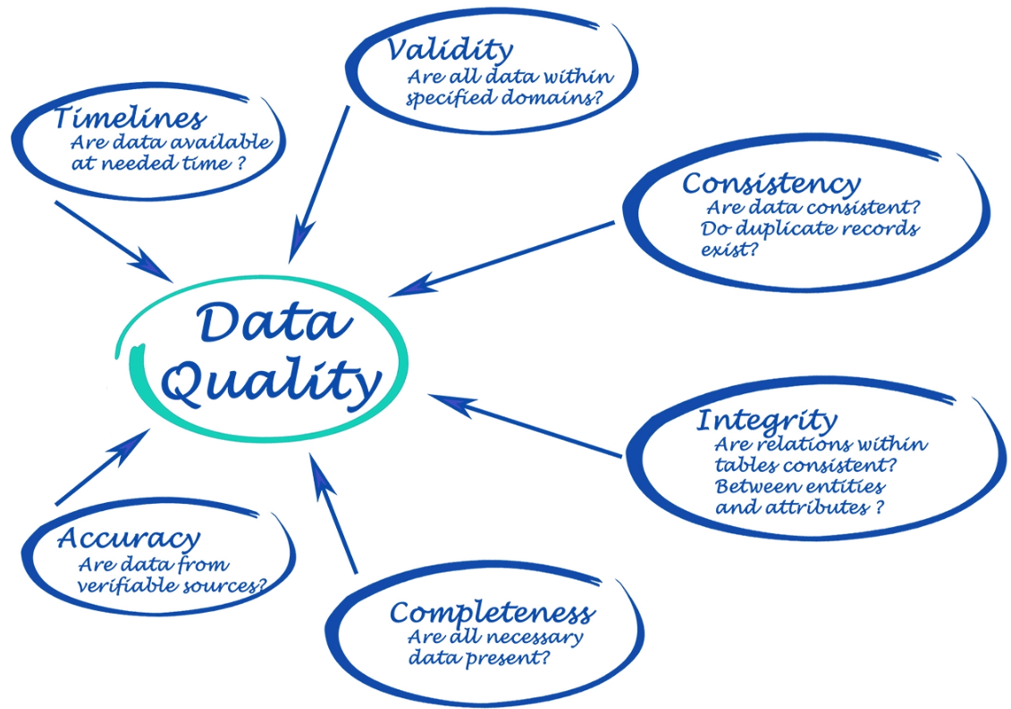
Data Validation Strategies

Slide 21
Data Validation Strategies
Data type-related checks:
Consistency
Special characters, etc.
Decimal point etc.
Verification of spans, totals, etc.
e.g. at %
Cross-reference check of validity
What do other data sources say?
Consistency check
Gaps etc.
Verification of references
…

Slide 22
On the Importance of FAIR Data
How can data be FAIR?
Findable: Data and metadata are easy to find by humans and machines
Accessible: Data can be retrieved using standardised, open protocols
Interoperable: Data use shared standards, formats, and vocabularies
Reusable: Data are well-described, licensed, and suitable for future use

Slide 23
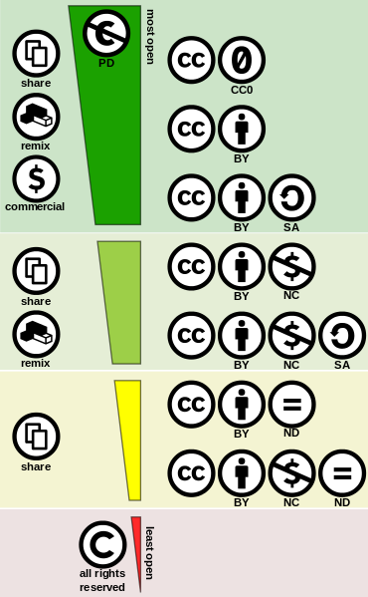
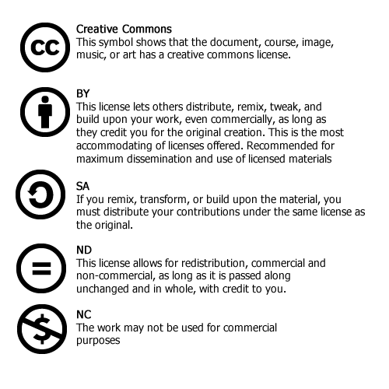
FAIR needs Licences: The Creatice Commons Licence Family

Slide 24

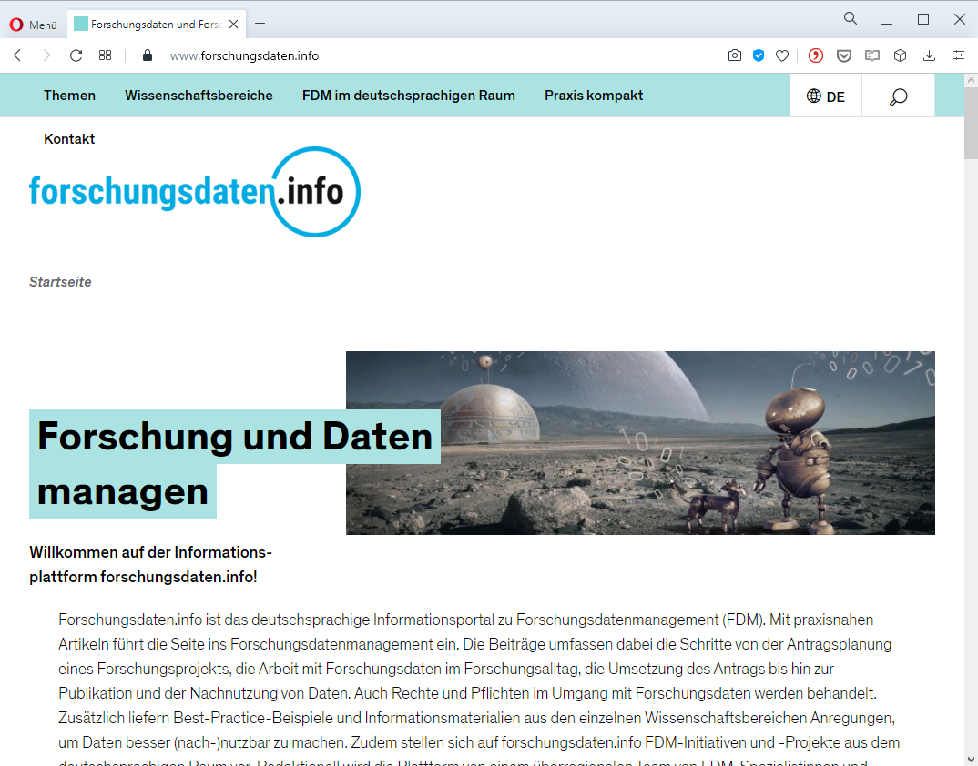
By the Way: Who “owns” the Data?
Notes:
Copyright law

Slide 25


From FAIR to Open Data
"All data sets that are made freely accessible in the public interest [...] without any restrictions on their free use, dissemination and reuse." (Lucke & Geiger 2010:4)
Access
Redistribution
Subsequent use
Absence of technological restrictions (SIC!)
No restrictions on use

Slide 26
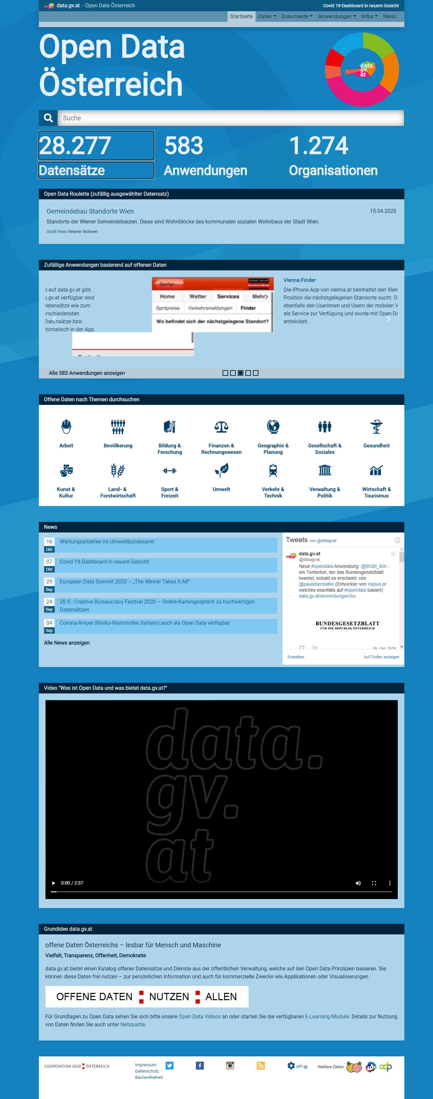
From FAIR to Open Data

Slide 27
Time 4 some Action

Slide 28
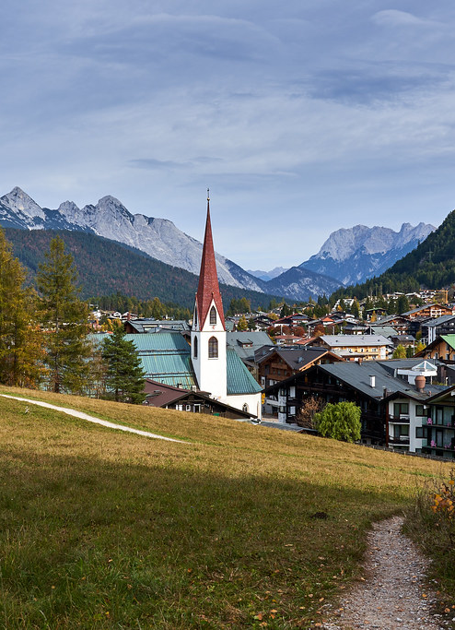
A little Experiment:
Tyrol … Idyllic in the Alps …
How many municipalities are there in Tyrol?
How many men and women live in each of these Tyrolean municipalities

Slide 29
ODF, CSV, TXT …

Slide 30
A typical Workflow
Reduction
Imputation
Aggregation
Classification
Generalisation
Documentation
Encoding problems
Data types
Labels
Completeness
Missing Values
Plausibility
Collect
Repositories
Define research questions
Data acqui-sition
Import data
Explore & validate data
Modify data
Model data
Validate models
Evaluate models
Documentation
Summarise findings
Univariate
Bivariate
Multivariat
Segment data record
Sensitivity analysis
Explanatory power
Number of variables
Effect strength

Slide 31
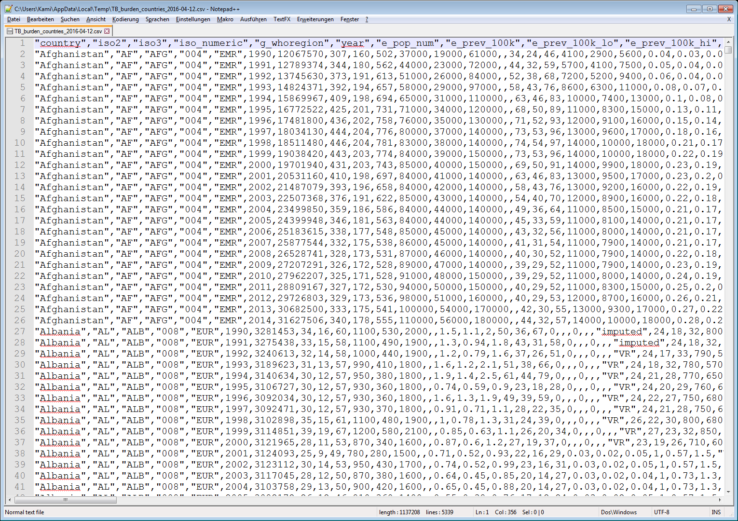
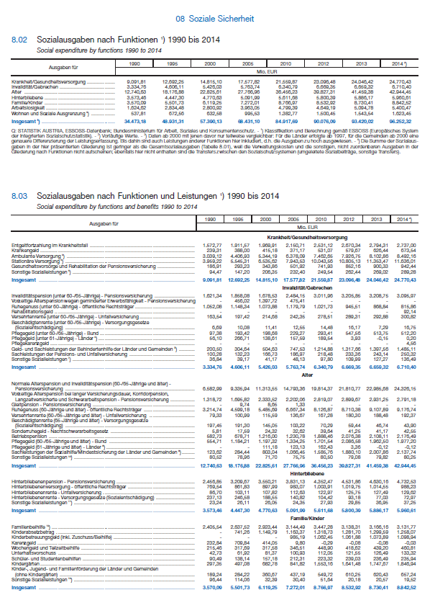

Data Formats, or: Welcome to the World of Pain 😉

Slide 32
Encoding?
different diacritical characters per language 👉 different character encodings of text
ASCII: American Standards Association - 1963
ISO standard: ISO 8859 for European languages
ISO 8859-1 (aka. Latin-1), extended ISO 8859-15
Windows: Windows-1252 Western European (= fusion of ISO 8859-1 and -15)
Unicode = ISO 10646 international standard
UTF-8: Universal Character Set Transformation Format 👉 De facto standard on the internet, but optimised for EN

Slide 33
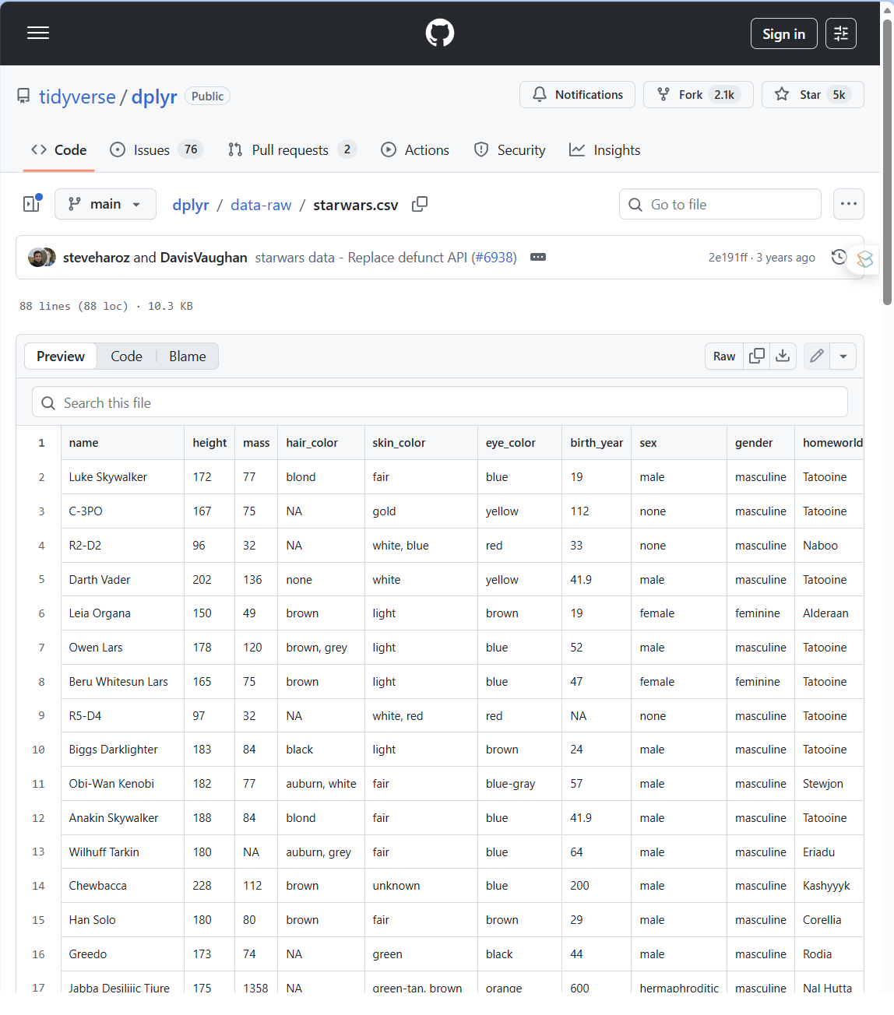
An Intergalactic Experiment: May the Force be With Us!
https://github.com/tidyverse/dplyr/blob/main/data-raw/starwars.csv

Slide 34
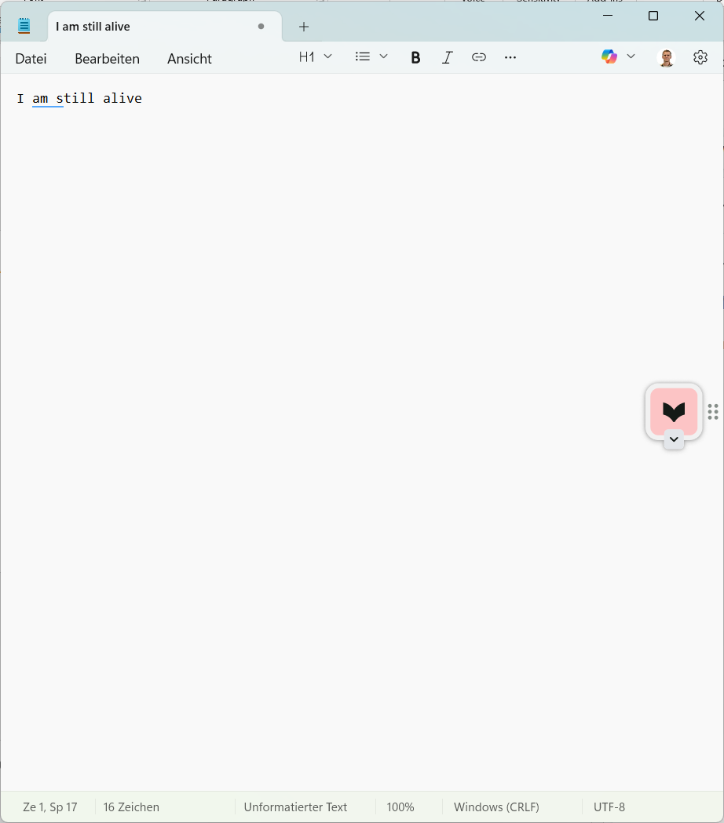
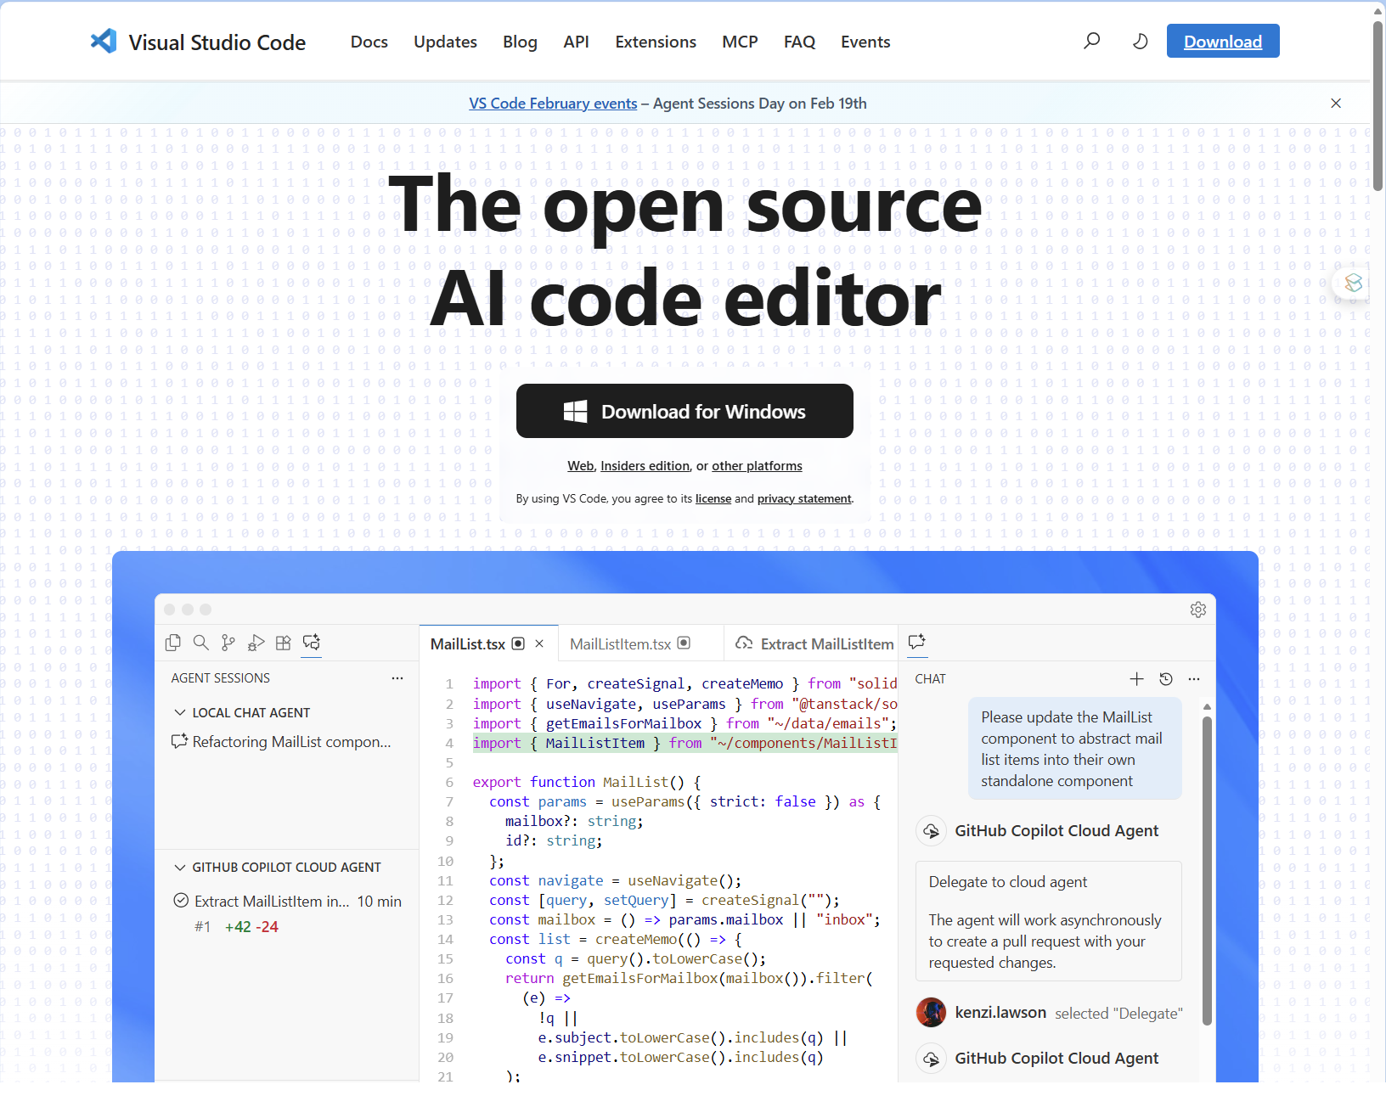
A Recommendation: Texteditors (still) Matter

Slide 35
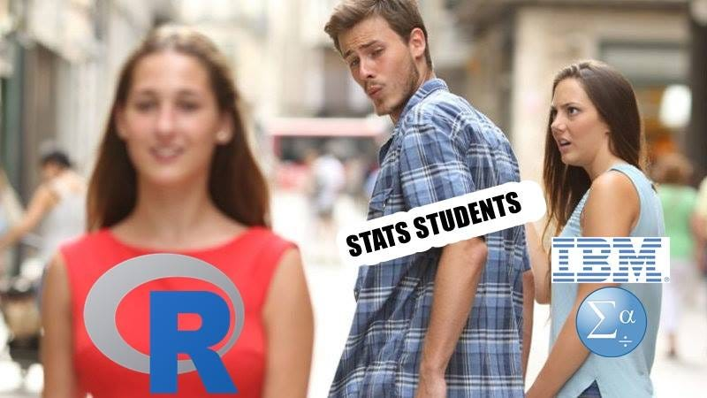
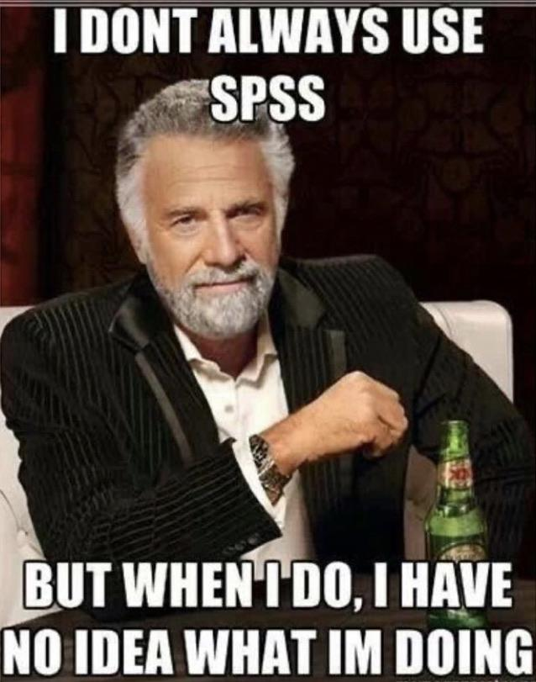

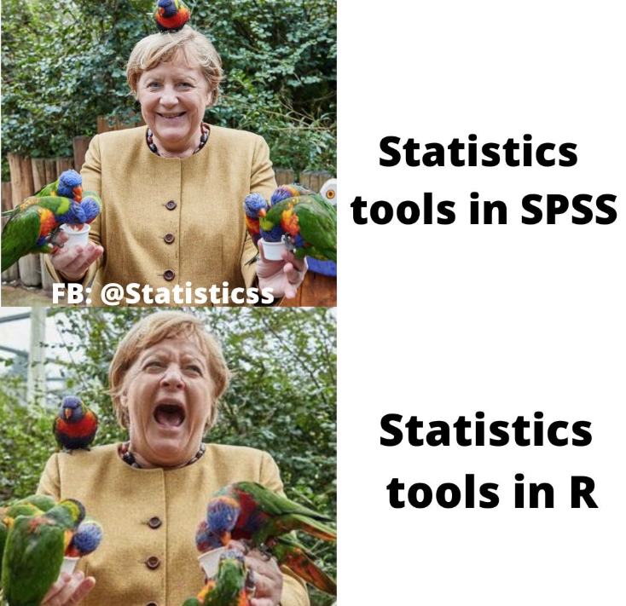
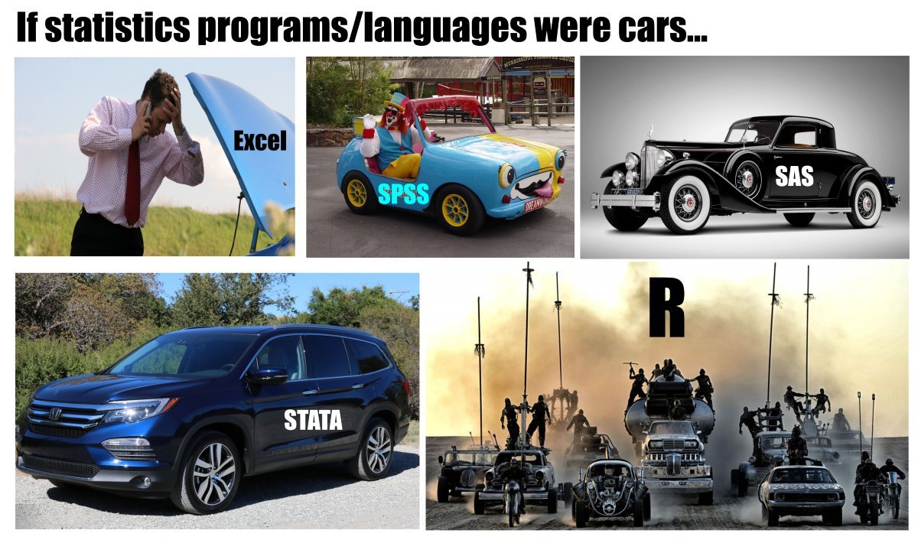
Please: Stay Calm …

Slide 36
Let’s Rock🤟

Slide 37
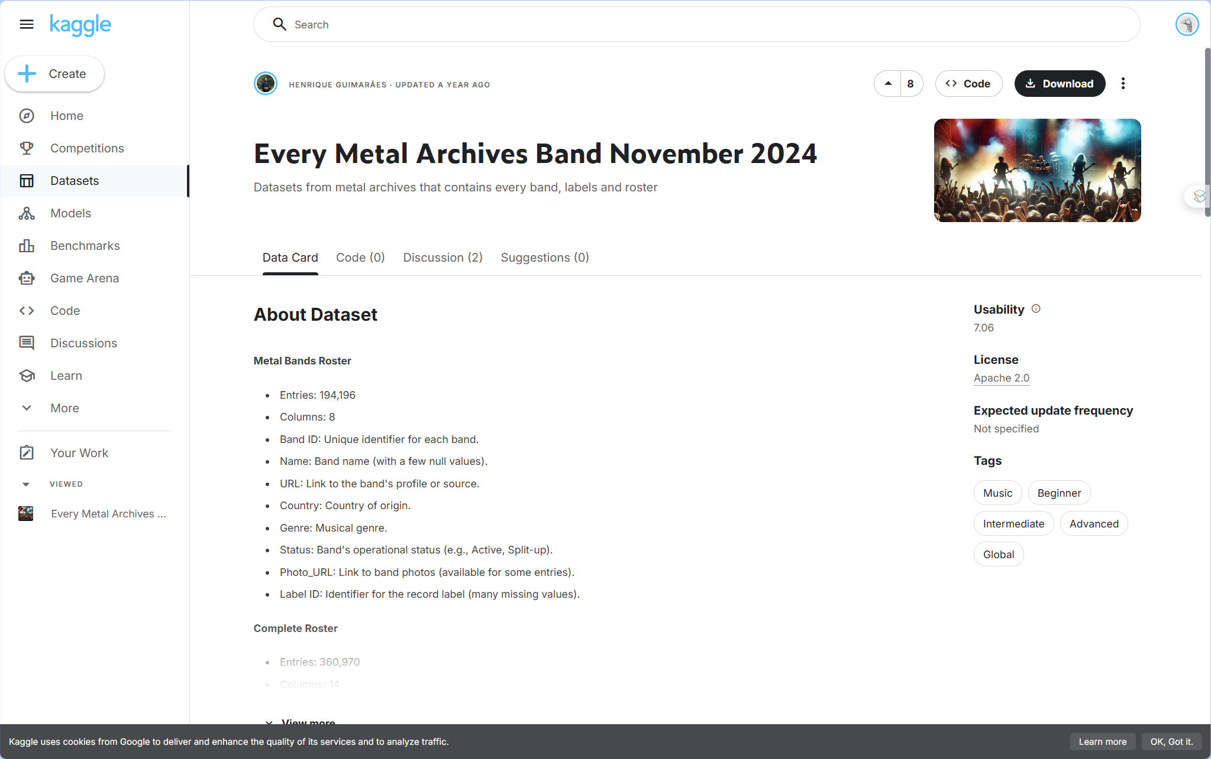
Let’s Rock🤟
Every Metal Archives Band November 2024Every Metal Archives Band November 2024

Slide 38
Outlook

Slide 39

Outlook

Slide 40
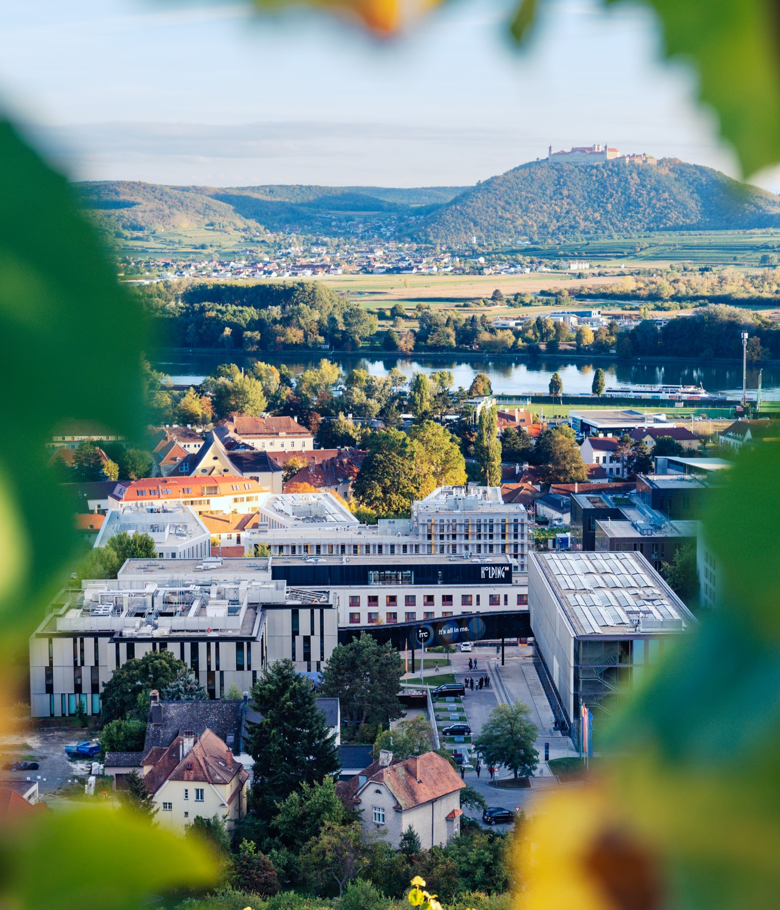

So long & cheerio!

